Slide 1
System Planning and Project Development (SYP)
Requirements
Unit 4

Slide 2
Every Project has Requirements
The hardest single part of building a software system is deciding precisely what to build
From the customer’s voice
Discussions
Observations
Unstructured data
To a technical description
Detailed technical requirements
Interfaces to people
Interfaces to machines
Interfaces to other systems

Slide 3

Functional and Non-Functional Requirements
Functional requirements
Features
Functions
Non-functional requirements
Availability
Usability
Robustness
Non-functional requirements
Maintainability
Portability
Reusability
Testability
Developer’s Perspective
User’s Perspective

Slide 4

Requirements Development and Requirements Management
Requirements
Requirements Development
Requirements Management
Elicitation
Specification
Baselining
Change Management
Analysis
Validation

Slide 5
Requirements Elicitation
Requirements Development
Elicitation
Specification
Analysis
Validation
Hearing the Customer’s Voice
Interview
(Self-)Observation
Elicitation Workshop
Questionnaire
Document study

Slide 6
Requirements Analysis
Requirements Development
Elicitation
Specification
Analysis
Validation
Domain Analysis
Speaking the Customer’s Language
Prototyping
Use Cases
User Stories
Notes:
Describe the domain
Describe the business rules
Glossary
More on this in the unit “System Specification”

Slide 7
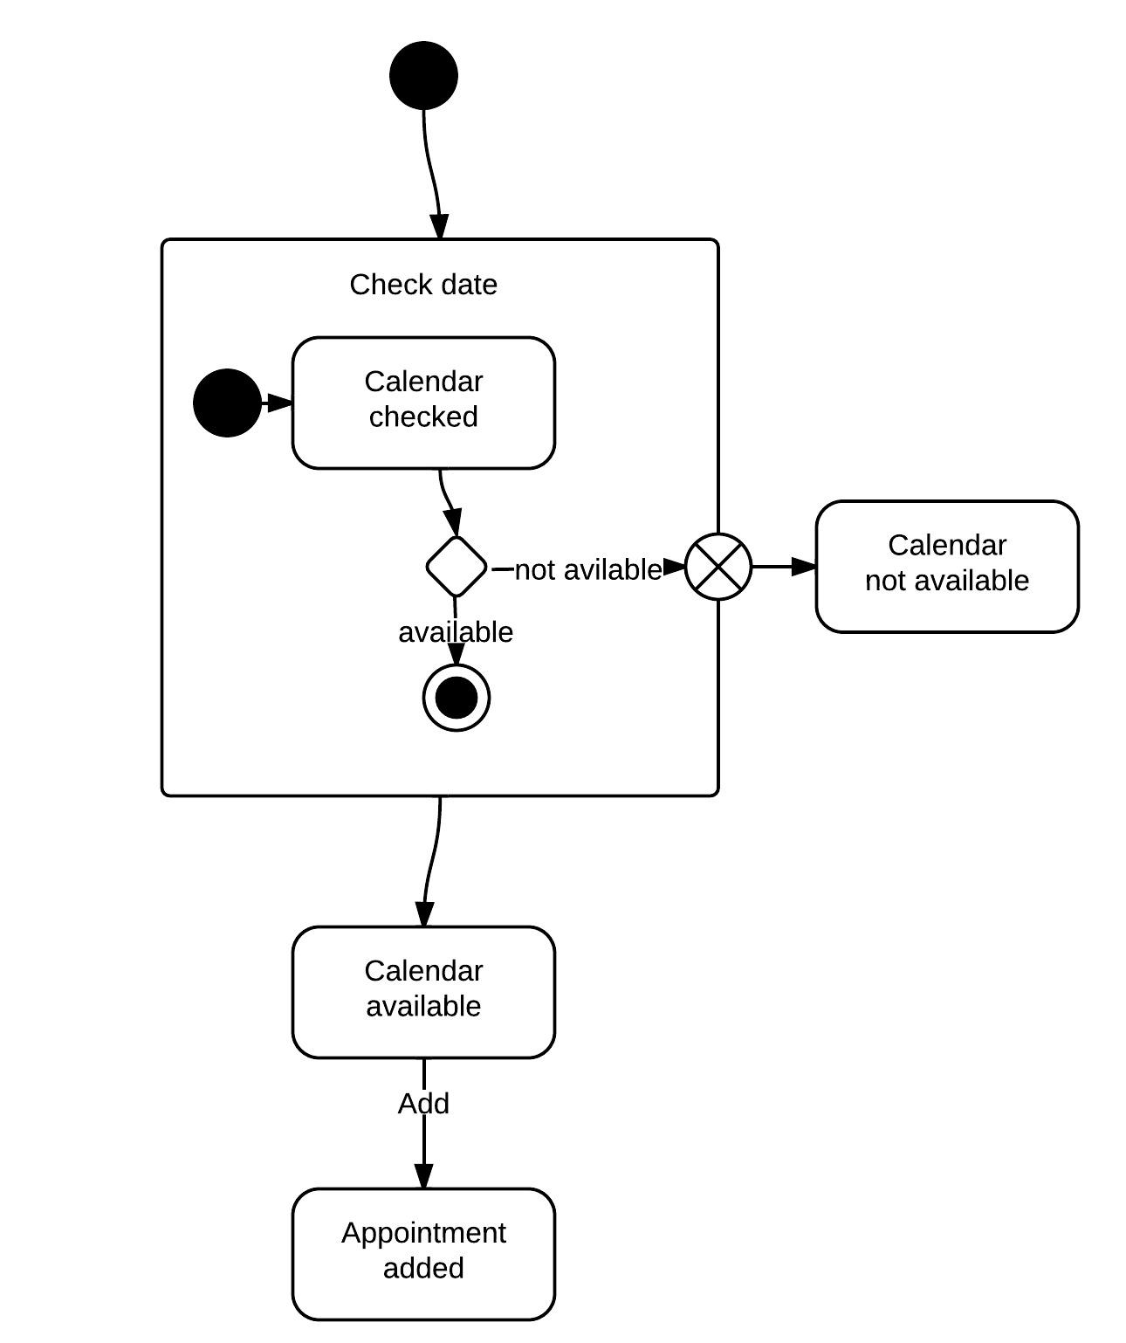
Use Cases / User Stories
Requirements Development
Elicitation
Specification
Analysis
Validation
Concentrate on WHAT not HOW
Start with customer’s perspective
Analyze the features of the planned system
Refine …
… to a technical perspective
Notes:
Details will come in a later unit

Slide 8
Throw-Away Prototypes
Requirements Development
Elicitation
Specification
Analysis
Validation
Make the user feel, how the final product will look like
Example: User interface without functionality behind
Avoid late disappointments about the product
Check out risky parts of the project by implementing it prototypically
Example: Response quality of mobile web application when used under bad coverage
Reduce risk of project fail in a late part
Agree with customer on a small feature set
Develop prototype
Release prototype
Evaluate prototype with customer
Throw away prototype

Slide 9
Evolutionary Prototype
Requirements Development
Elicitation
Specification
Analysis
Validation
Drive the development in very small increments
Requirements analysis and software development go in parallel
To some extent the work cycle of agile project development methods
Agree with customer on a small feature set
Develop/Enhance prototype
Release prototype
No
Evaluate prototype with customer
Prototype ok?
Yes

Slide 10
Requirements Specification
Requirements Development
Elicitation
Specification
Analysis
Validation
Document the requirements
Domain Analysis
Functional
Non-functional
Quantities
Embedding into and interfaces to existing infrastructure
Acceptance criteria
Notes:
Details will come

Slide 11
Validating Requirements
Requirements Development
Elicitation
Specification
Analysis
Validation
Requirements Specification to be reviewed thoroughly WITH the customer
Most effective: Write acceptance tests
Based on use cases / user stories
Normally business of the customer
Cuts a clear line whether feature is “done” when it comes to implementation

Slide 12
Requirements Sign-Off
Requirements Development
Elicitation
Specification
Analysis
Validation
Do not think waterfall
Requirements are not developed and then done
Interpretation of “Sign-off”
Requirements development is mostly done
Rules of requirements management now apply

Slide 13
Requirements Development and Requirements Management
Requirements
Requirements Development
Requirements Management
Elicitation
Specification
Baselining
Change Management
Analysis
Validation

Slide 14
Baselining – Increment 1
Requirements Management
Baselining
Change Management
Select and agree requirements
Requirement 1
Requirement 2
Requirement 3
Requirement 4
Requirement 5
Requirement 6
Requirement 7
Requirement 8
Requirement 9
…
Requirement 1
Requirement 2
Requirement 3
Requirement 4
Requirement 5
Requirement 6
Requirement 7
Requirement 8
Requirement 9
…
Implement
Test
Release
Synced
Product
Notes:
Features come in increments
Increment i
Set of requirements agreed to be implemented
Version Control
Controlled change

Slide 15
Baselining – Increment 2
Requirements Management
Baselining
Change Management
Requirement 1
Requirement 2
Requirement 3
Requirement 4
Requirement 5
Requirement 6
Requirement 7
Requirement 8
Requirement 9
…
Requirement 1
Requirement 2
Requirement 3
Requirement 4
Requirement 5
Requirement 6
Requirement 7
Requirement 8
Requirement 9
…
Controlled changes of requirements if any
Implement
Test
Release
Synced
Product
Notes:
Features come in increments
Increment i
Set of requirements agreed to be implemented
Version Control
Controlled change

Slide 16
Change Management
Requirements Management
Baselining
Change Management
The Times They Are A Changin’ (Bob Dylan, 1964)
The Requirements They Are A Changin’ (Peter Bauer, 2012)

Slide 17
Healthy Change vs. Scope Creep
Requirements Management
Baselining
Change Management
(In software) requirements have to change
Best ideas come, when you have the first ideas in hand
Nevertheless, creeping requirements at a late project stage may spoil a project seriously
Take care of a thorough requirements development
Learn how to say “NO”

Slide 18
Change Control Board
Requirements Management
Baselining
Change Management
After requirements development is finished
Requirements changes must be handled carefully
Change Control Board (CCB) takes care of change requests (CR)
Customer
Product owner

Slide 19
Change Control Process
Requirements Management
Baselining
Change Management
Somebody raises a
change request (CR)
Technical feasibility
Effort
Impact to time line
Submitted
Team evaluates
impact of CR
Evaluated
CCB decides not to
make the change
Rejected
CCB decides to
make the change
From here requirement is added to requirements list
Approved

Slide 20
Summary
Requirements are central to every software project
Crucial is the translation from the customer’s language to a technical view
Non-functional requirements must be considered as important as functional requirements
A thorough requirements development is crucial for a successful project
In later project stages a careful change management is necessary

